Slide 1
Interview Exercise
Leonard Maaya

Slide 2
Questions

Slide 3
1. Cartridge detection rates (‘positive call rates’) vs input level.
Input Level (copies/ml) | N | Detected (%)
125 | 24 | 18(0.75)
250 | 23 | 21(0.91)
500 | 23 | 23(1.00)
750 | 24 | 24(1.00)
1,000 | 24 | 24(1.00)
2,000 | 24 | 24(1.00)
4,000 | 24 | 24(1.00)

Slide 4
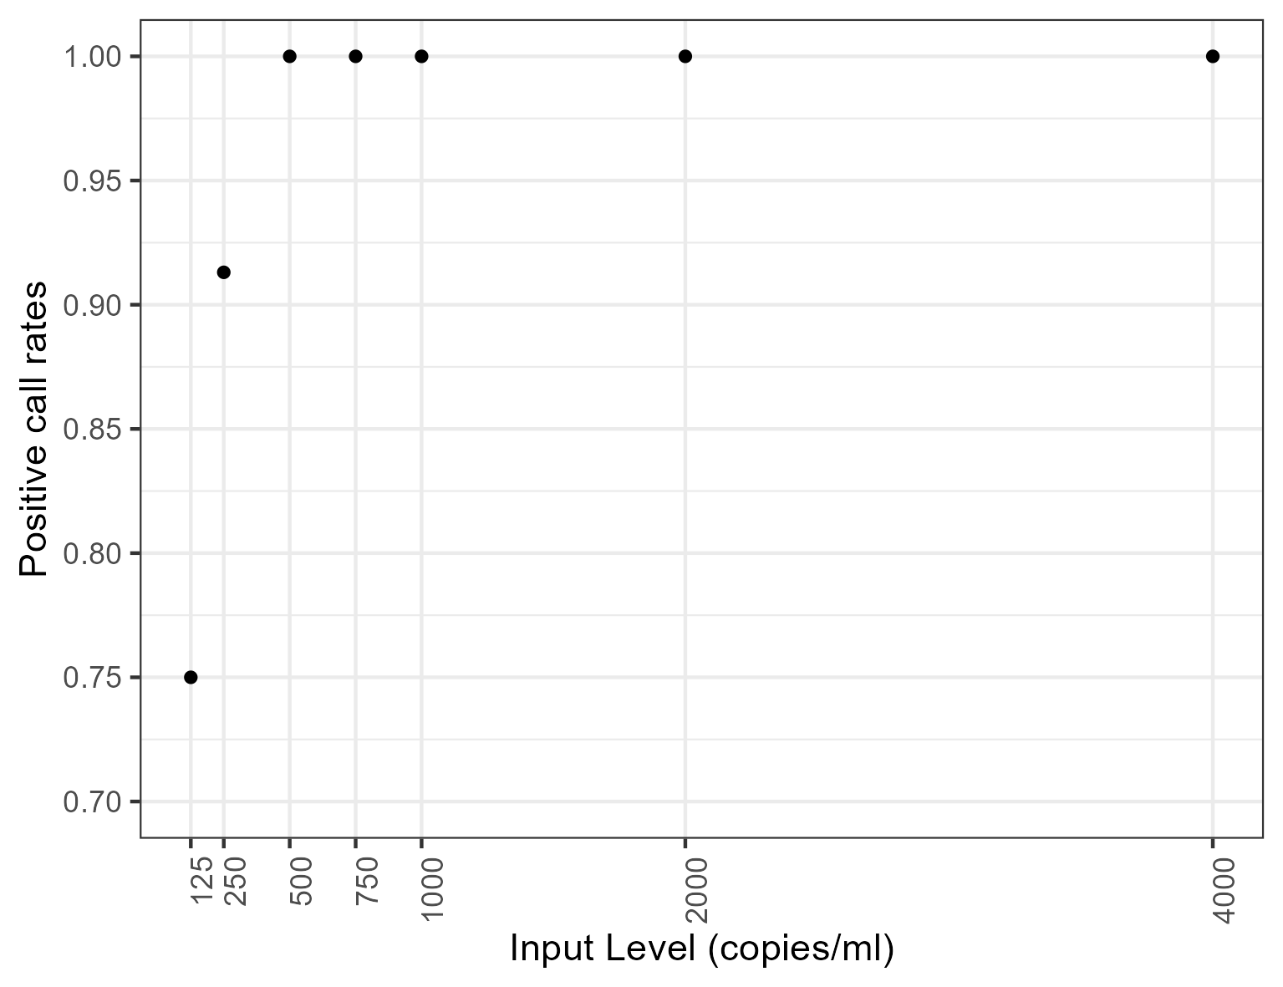
2. Positive call rates vs input levels.

Slide 5
3. Statistical model
Lowest input level (cps/ml) with 95% positive call rates:
285
Corresponding 95% Wilson CI for the input level (cps/ml):
c(147, 423)

Slide 6
To be checked
Operator vs Positive call rates
Day vs Positive call rates
Day-Operator vs Positive call rates

Slide 7
Modeling
Include the other variables?
Bayesian?

